Slide 1
Predict the price of homes at sale for the Ames Iowa Housing
Mini Project 2 Regression Challenge
Kelvin Liew
12th March 2022

Slide 2
The Approach
01
Define
02
Prepare
03
Analyze
04
Deliver
Understand the business needs
Understand the factors that influence a home’s value
Understand the data source by referencing the data dictionary
Outline some of the most important factors and features for the models
Define the goals
Investigate the data feature
Data cleaning to ensure data is correct and useable
Data preprocessing involves transforming raw data into an understandable format.
Data visualization with the ordinal, nominal and categorical variables
Finalize data preprocessing for the training dataset
Establish a baseline score
Model selections – several linear regression models are tested on this dataset
Optimize the model for deployment into production
Visualize the results
Summarize the finding in business language as much as possible
Approval to deploy into production
Monitoring of the model

Slide 3

The problem
The goal of this project is to reduce the time it takes for home-seekers
Make the home buying process easier for their customers
Accurately predict the house price in Ames lowa
Increasing sales, reducing time spent by our realtors on each customer, and increasing the company's referral rate by providing a better home match for of each customer
8 critical factors that influence a home’s value
Neighborhood
Location
Home Size & Usable Space
Age & Condition
Upgrades & Updates
The local market
Economic indicators
Interest rates
The solution
Adding descriptive data modelling as a feature to predict the housing in Ames lowa

Slide 4
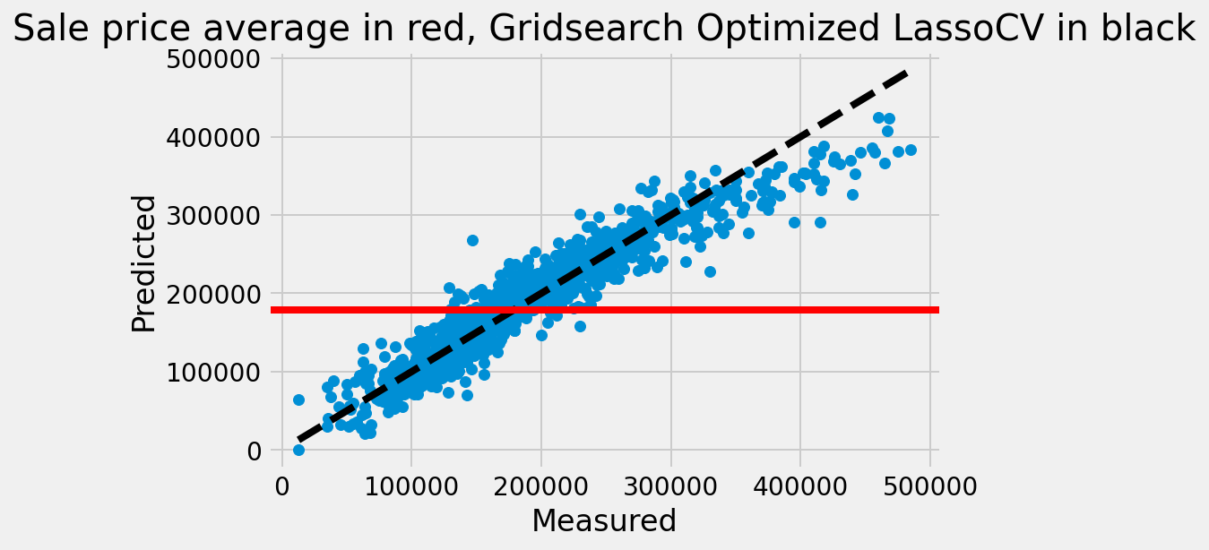
The Model
Benchmark Mean Root Square Error (RMSE) to beat: $73,422.04
Model Performance
Cross Validated R^2 Score of 89.41%
Ames Model RMSE: $22,783.6
31 features included:
Dummy variables, 9
Discrete variables, 3
Continuous variables, 8
Ordinal variables, 11
Notes:
The data set used includes 2051 records and 81 feature columns
These 81 feature columns are combined to better represent the drivers of sale price or dropped if the feature does not add to the explanation of sale price in a significant way
The model uses 31 features
Features were selected using a combination of correlation to house sale price, lassocv as feature selection, p-value evaluation, and domain knowledge
Missing values were filled with a combination of zero values and averages based on the requirement of the feature
In total only 13 records were dropped from the original dataset
The selected model was not the best at predicting price, but instead is the best balance of predictability and interpretability
The chosen model has an R^2 score of around 89%

Slide 5
Examined Features
Home Type
Location
Type of house
If the house was remodeled
New houses cost more
10 Overall Quality bins
Value added if no deductions from damage
Neighborhood
Local Conditions
Exterior
Roof Style
Paved Driveway
5 Overall External Quality
Garage Vehicle Space
Others
Interior
Area of lot connected to the street
Total lot area
Heating quality
Room size
Basement Outdoor Exposure
Kitchen Quality
Fireplace Quality
Additional Room

Slide 6
Final Comments
When possible, choose homes in the same subdivision. This is because the house a block over may not be a good comparable if it belongs to a different subdivision with different HOA rules, school district, and transit options
Choose homes that are the most similar in terms of features like the type of home (two-story vs. ranch), year built, number of bedrooms, bathrooms, and square footage
03
04
Feature Similarity
Distance
Look for homes that were recently sold—the more recent, the better
02
05
If the home has a unique placement, such as on a busy street, golf course, or waterfront, look for comps that have the same placement
Recency
Location
01
06
Deeper domain knowledge will improve ML algorithm
A value attached to the examined features will provide more information to homeowners and buyers
Domain Knowledge
Dollar Attached to Feature

Slide 7
Appendix

Slide 8
Data Dictionary (1/3)
Feature Name | Grouping | Description | Engineered Variable | Variable Type
neighborhood_order | Location Feature | Neighbourhood binned by price (1-4) | Yes, binned | Ordinal
local_conditions | Location Feature | Location Features binned by desirability (1-3) | No change | Ordinal
was_remodeled | Interior Feature | If the house was remodeled (1), if not (0) | Yes, binned | Dummy
overall_qual | Interior Feature | Overall quality of house material (1-10) | No change | Discrete
bsmt_qual | Interior Feature | Overall quality of basement material (0-4) | No change | Ordinal
bsmt_type*sf_all | Interior Feature | Basement livability multiplied by bsmt sqft | Yes, Interaction variable | Continuous
bsmt_exposure | Interior Feature | Outside exposure of bsmt (if exists) (0-4) | Yes, binned | Ordinal
heating_qc | Interior Feature | Heating quality and condition (1-5) | Yes, binned | Ordinal
kitchen_qual | Interior Feature | Kitchen Quality (1-5) | Yes, binned | Ordinal
fireplace_qu | Interior Feature | Fireplace Quality (if exists) (0-5) | Yes, binned | Ordinal
quality_above_sqft | Interior Feature | Finished sqft of house above ground | Quality (1-5) multiplied by sqft above ground | Continuous

Slide 9
Data Dictionary (2/3)
Feature Name | Grouping | Description | Engineered Variable | Variable Type
totrms_abvgrd | Interior Feature | Total rooms above ground | No change | Discrete
room_size | Interior Feature | Average size of above ground rooms in sqft | Yes, total rooms divided by total sqft | Continuous
age | Home Type Feature | Age of house at time of sale | Year house sold minus year house built | Discrete
house_style_condensed_2.0 | Home Type Feature | 1 if a two story house, 0 if 1 story house | Yes, dummied | Dummy
bldg_type_TwnhsE | Home Type Feature | 1 if Townhouse end unit | Yes, in reference to single-fam house | Dummy
bldg_type_Twnhs | Home Type Feature | 1 if Townhouse inside unit | Yes, in reference to single-fam house | Dummy
bldg_type_2fmCon | Home Type Feature | 1 if Two family conversion house | Yes, in reference to single-fam house | Dummy

Slide 10
Data Dictionary (3/3)
Feature Name | Grouping | Description | Engineered Variable | Variable Type
exter_qual | Exterior Feature | Overall External material quality (1-5) | No change | Ordinal
external_feature | Exterior Feature | External Feature binned by desirability (1-10) | Yes, combination of Exterior 1 and 2 | Ordinal
is_hip_roof | Exterior Feature | 1 if roof type flat/hip/shed, 0 if mansard/gable/gabrel | Yes, dummied | Dummy
mas_vnr_area | Exterior Feature | Masonry veneer area in square feet | No change | Continuous
Functional | Exterior Feature | 1 if no deduction from damage, else 0 | Yes, binned | Dummy
lot_frontage | Exterior Feature | Area in square feet of property connected to street | No change | Continuous
lot_area | Exterior Feature | Lot area in square feet | No change | Continuous
developed_outside_sf | Exterior Feature | Deck and patio space | Yes, combination of deck and patio sqft | Continuous
garage_fin*sqft | Exterior Feature | Quality garage space | Quality of garage finish multiplied by sqft garage | Continuous
garage_cars | Exterior Feature | Number of vehicles garage can fit | No change | Discrete
paved_drive | Exterior Feature | If driveway unpaved, dirt/gravel, paved (1-3) | Yes, binned into ordinal | Ordinal

Slide 11
Model Selection
Model Used | R^2 | RMSE in Dollars | Pipeline Build | Hyperparameter Optimization
Baseline Model | 0 | 73,422.04 | No | No
Scaled Linear Regression | 0.8834 | 22,774.76 | No | No
RidgeCV Linear Regression | 0.8837 | 22,776.82 | No | Standard Scaler, Alphas using RidgeCV
LassoCV Linear Regression | 0.8837 | 22,780.88 | No | Standard Scaler, Alphas using LassoCV
RidgeCV Gridsearch | 0.8940 | 22,776.10 | Yes | Standard Scaler, Gridsearch searches for the best values
Lasso Gridsearch | 0.8941 | 22,783.60 | Yes | Standard Scaler, Alphas using LassoCV Gridsearch searches
Lasso Coef_ | 0.8942 | 22,783.60 | Yes | Standard Scaler, Alphas using LassoCV Gridsearch searches
Lasso Model with polynomial features | 0 | 17,351.63 | Yes | Polynomial, Standard Scaler, Alphas using LassoCV, Gridsearch searches
Elastic Net | 0.8938 | 22,852.39 | Yes | Elasticnet, Standard Scaler, Gridsearch searches for the best values
Cross Validated R^2 Score of 90.22% on Train dataset

Slide 12
THANK
YOU

